Slide 1

HACK KRMU 5.0
Problem Statement ID : AR VR
Team Name : THE HasHIRAS
TEAM ID : HK-003
TEAM MEMBERS : MUKUL
MUSKAN Saini
gurudutt
ayush arya
01

Slide 2






HACK KRMU 5.0
Problem & SOLUTION
5 problems
Need to download too many AR apps for different experiences
1 optimal solution
Different Apps use different engines, hence different dependency had to be downloaded
A Single App for Various AR Models
AR Apps use large storage space due to heavy assets
Easy updates for newer versions
Based on One Defined Game Engine
No prominant AR Based Learning App
All Offline Interface makes it stable.
Need for AR Based Learning in Health, Tourism, Nutrition and Fitness Sector.
Quality assets along with very memory effecient app size
02

Slide 3
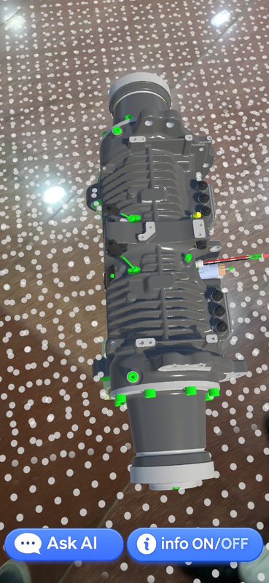
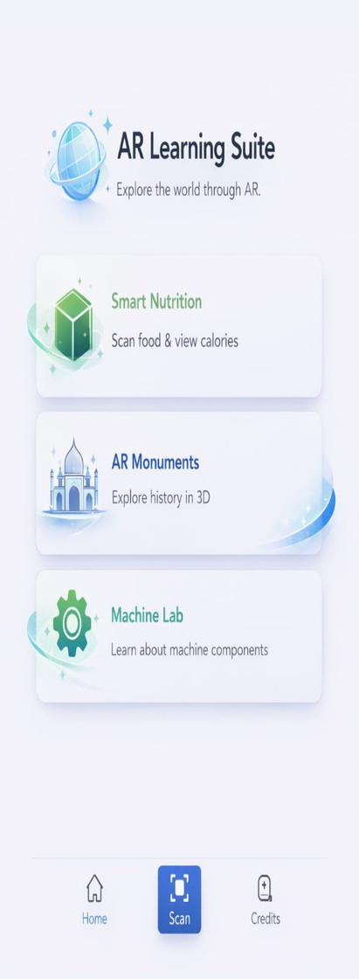
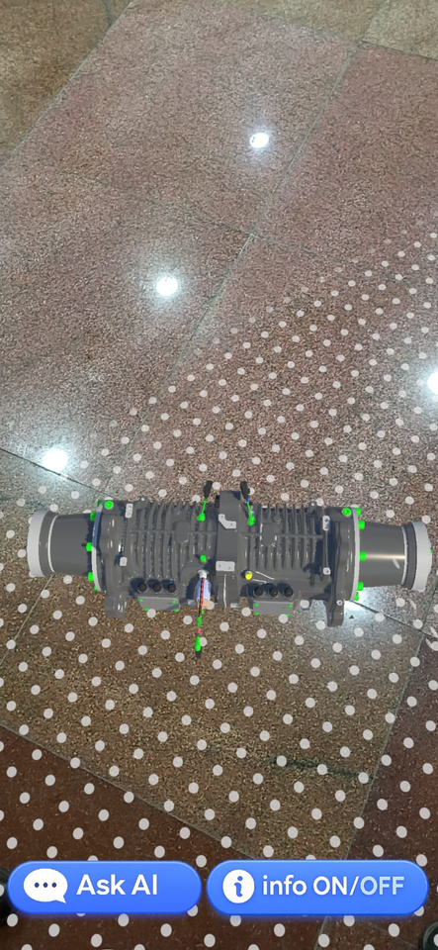
HACK KRMU 5.0
FLOW OF SOLUTION
User opens AR Learning Suite
Select AR learning module
AR Engine activates camera
AI / AR processes object
Displays interactive AR content
03

Slide 4
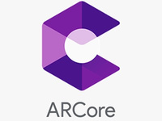
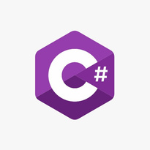



HACK KRMU 5.0
TECH STACK & APPROACH
Techstack
Approaches
AR Engine (ARCore)
Scripting Language (C#)
3D Modelling (Blender)
Game Engine (Unity)
ML integration (Colab)
Developed AR Learning Suite as a modular Unity-based platform
Integrated ARCore for real-world object tracking and visualization
Created multiple AR learning modules inside one app
Used MobileNet AI for intelligent object detection
Optimized system using TensorFlow Lite for mobile devices
Designed scalable platform to support future AR learning apps
04

Slide 5
HACK KRMU 5.0
UNIQUENESS & INNOVATION FACTOR
Multi-Domain AR Platform
Smart Nutrition, AR Monuments, and Machine Lab in one unified app.
AI-Powered Engineering Assistant (RAG-Based)
Domain-trained chatbot using custom vector database — not generic AI replies.
Persistent AR Placement
Models remain stable even after marker removal.
Mobile-Optimized AI Stack
TensorFlow Lite + Lightweight LLM + ARM64 optimized build.
Modular & Scalable Architecture
Easily extendable to healthcare, agriculture, education, and more.
•
05

Slide 6
HACK KRMU 5.0
Feasibility & Challenges
✅ Feasibility
Built on stable stack: Unity 2022 LTS + AR Foundation + ARCore
Mobile-optimized AI: TensorFlow Lite + Lightweight LLM
ARM64 + IL2CPP optimized Android build
Modular architecture for easy scaling and future expansion
⚠️ Key Challenges
AR tracking accuracy under varied lighting
Optimizing AI performance on mobile devices
Managing memory across multiple AR scenes
Ensuring reliable backend–app communication
06

Slide 7
HACK KRMU 5.0
Research & Reference
Unity Documentation – AR Foundation & XR Plugin Management
Google ARCore Developer Guidelines
TensorFlow Lite Documentation (Mobile AI Optimization)
Hugging Face Transformers & Sentence-Transformers Research
MobileNetV2 – (Efficient CNN for Mobile Devices)
Human–Computer Interaction Studies in AR-Based Learning Systems
07

